Slide 1
Portfolio Optimization, and Hedging using Natural Language Processing
Sample Group 5

Slide 2
Introduction
Premise of our project
1
Using Machine Learning to predict returns
Machine Learning
Basket of Equities Selected
2
Testing Various Optimization Techniques to create portfolio based on predicted returns
Top 16 Dow Jones 30 Equities by Market Capitalization
AMZN | AAPL | V | CSCO
HD | JNJ | KO | JPM
MMM | MSFT | PG | CVX
UNH | CRM | NVDA | WMT
Portfolio Optimization
3
Using News Article Headlines to analyse stock’s sentiment
Natural Language Processing
Time Frame
4
Using sentiment analysis to hedge our previously optimized portfolio
5 years – Beginning 2020 to End 2024
Interval: Monthly data – So there is sufficient news to react on
Hedging
5
Comparing our various portfolios to other benchmarked portfolios
Benchmark Comparison

Slide 3
Machine Learning

Slide 4
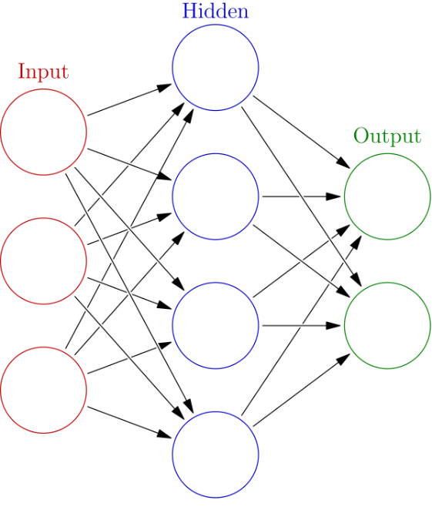

Neural Network Model
Neural Networks
Features
Architecture
model = Sequential()
model.add(Dense(256, activation=‘relu’, input_shape=(X_train.shape[1],)))
model.add(Dropout(0.3))
model.add(Dense(128, activation=‘relu’))
model.add(Dropout(0.2))
model.add(Dense(64, activation=‘relu’))
model.add(Dense(1, activation=‘linear’))
model.compile(optimizer=‘adam’, loss=‘mean_squared_error’)
Model Complex Relationships
High Dimensional Data
Input
Daily Returns for last 3M
Target
Terminal Return for Current Month
Loss Function: MSE
Train-Test Split: 8:2
Period: 1/1/2015 – 31/12/2019

Slide 5
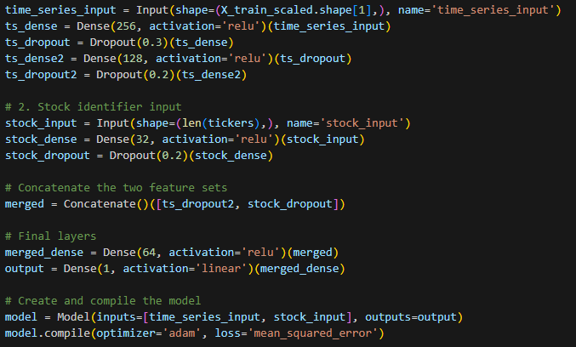
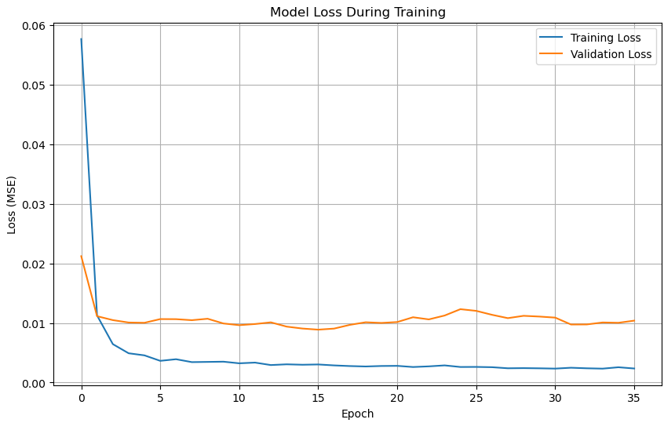
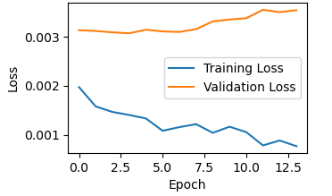
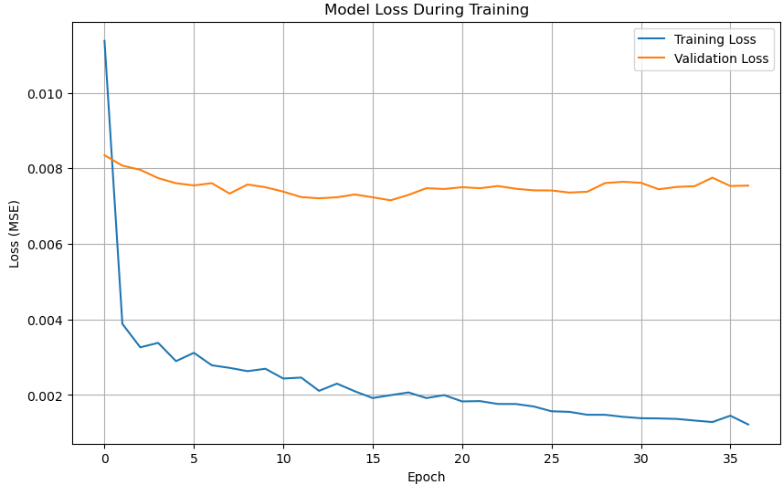
Neural Network Model
Encode Stocks
1 Model per Stock
Merged Data
Additional Features
Loss function for Visa
Rolling 3 month moving average
Rolling 3-month volatility
Mean Squared Error
0.0039
Mean Absolute Error
0.0496
Mean Squared Error
0.0049
Mean Absolute Error
0.0486
Mean Squared Error
0.0045
Mean Absolute Error
0.0472

Slide 6
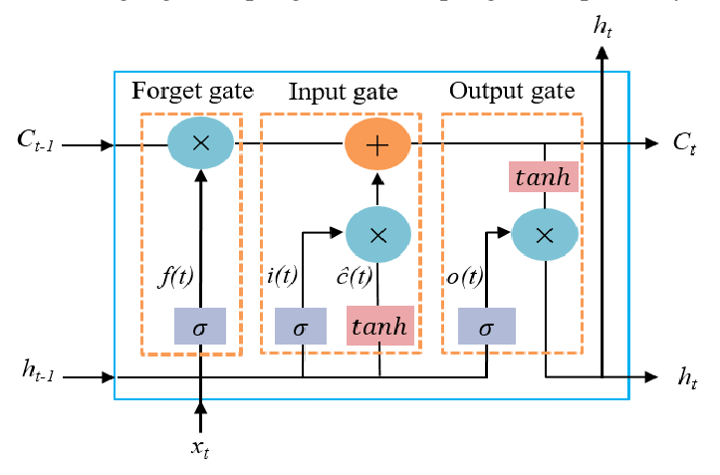
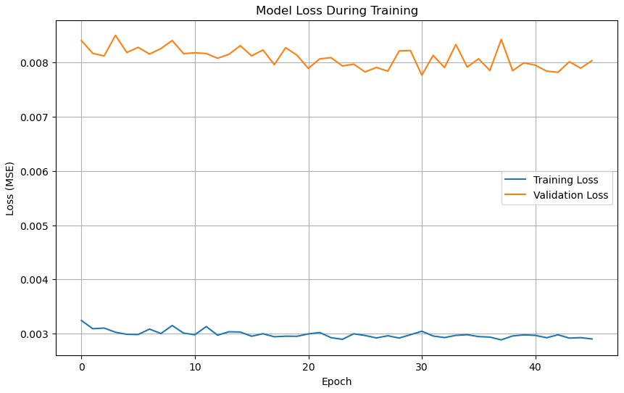
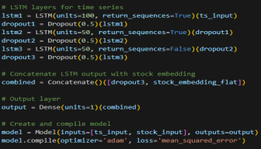
Long Short-Term Memory (LSTM)
Memory Gates
Performance
Pass on information for prediction at future timesteps
Ideal for time series forecast
Architecture
Mean Squared Error
Mean Absolute Error
0.0036
0.0433

Slide 7
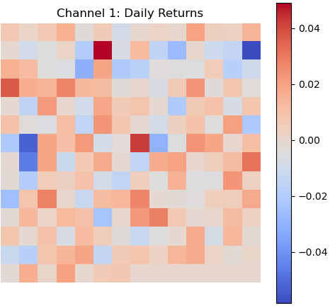
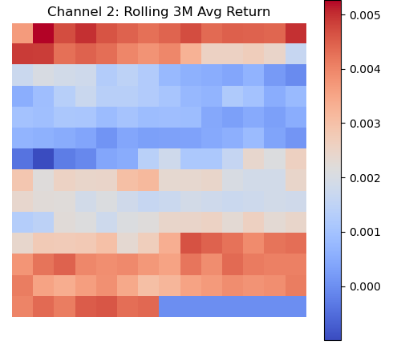
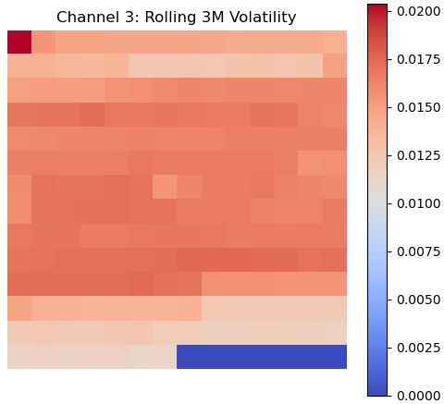
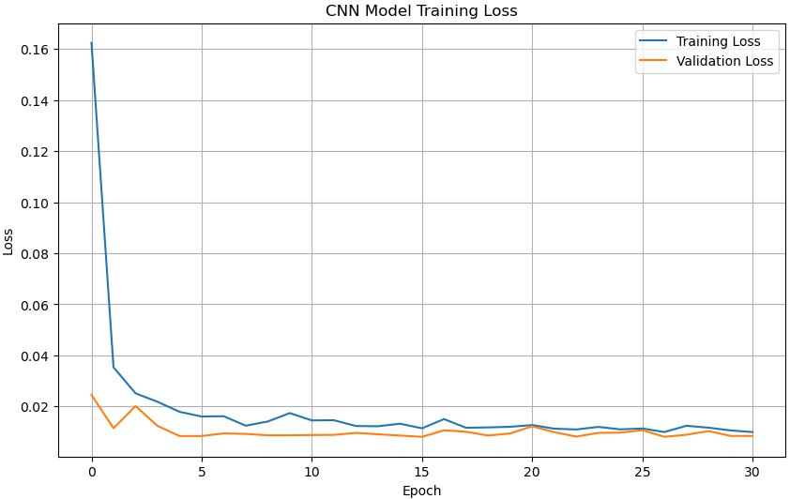
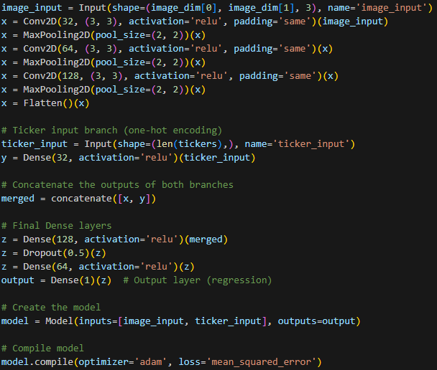
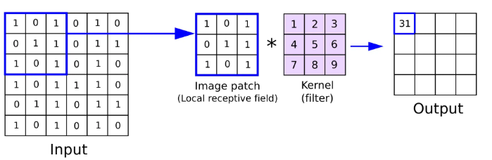
Convolutional Neural Network (CNN)
CNN Model
Performance
Target Return
Mean Squared Error
Mean Absolute Error
0.0241
0.1077

Slide 8
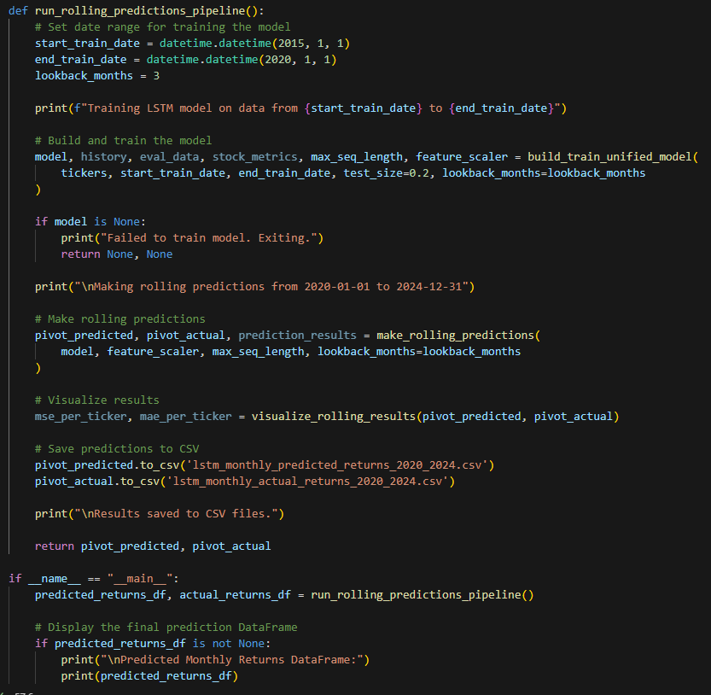
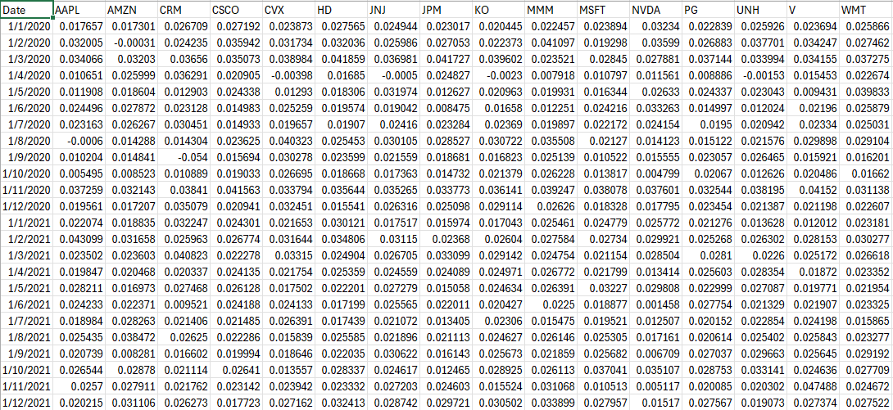
Output
LSTM Output Code
CSV Output

Slide 9
Portfolio Optimization

Slide 10

Introduction to Portfolio Optimization
What is Portfolio Optimization
1
Mean Variance Optimization:
Optimize portfolio weights to achieve best risk to return trade-off.
Portfolio Optimization is the process of choosing the best possible mix of assets in a portfolio to achieve a specific goal.
Mean Variance Optimization
Do we need risk free assets?
How much to put in equity?
2
Min Variance Optimization:
Optimize portfolio weights to minimize the total risk of the portfolio.
How much to put in bonds?
Min Variance
Optimization
3
Max Sharpe Optimization:
Optimize portfolio weights to maximize the Sharpe Ratio of the portfolio.
Maximize Return
Minimize
Risk
Balance
Risk & Return
Max Sharpe
Optimization

Slide 11

Process of Portfolio Optimization
Optimization Models
Output Source
1
Input Source
lstm_monthly_predicted_ returns_2020_2024.csv
Mean Variance Optimization
MVO_Weights.xlsx
2
Min Variance
Optimization
Min_Var_Weights.xlsx
3
Max Sharpe Ratio
Optimization
Sharpe_Weights.xlsx

Slide 12
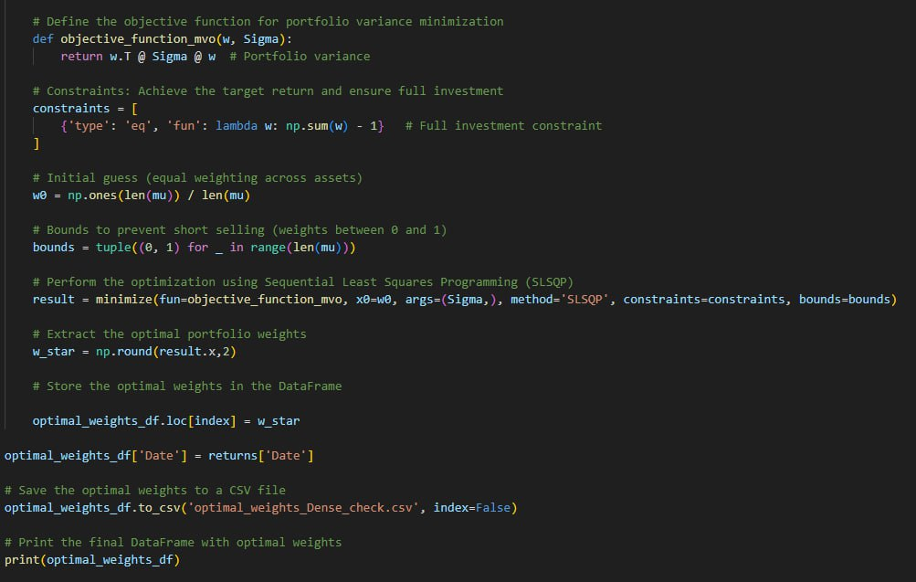
Min Variance Optimization Code
Key Processes
1
LOAD IMPORTED DATA
Min Variance Optimization Code
2
DEFINE PORTFOLIO STOCK BASKET
3
LOOP THROUGH EACH MONTH
4
ANNUALIZE RISK & RETURN
5
SET OPTIMIZATION CONSTRAINT
6
UTILIZE “SCIPY.OPTIMIZE.MINIMIZE”
7
STORE OPTIMIZED WEIGHTS INTO CSV
8
FINAL OUTPUT: CSV FILE

Slide 13
Table of Comparison (Optimization)
Step | Sharpe Ratio | Mean Var Optimization (Target Rn) | Min Var Optimization (No Target)
Read Predicted Returns | ✅ From CSV | ✅ From CSV | ✅ From CSV
Select Stocks | ✅ 16 tickers | ✅ 16 tickers | ✅ 16 tickers
Historical Price Data | ✅ 3-month via yfinance | ✅ 3-month via yfinance | ✅ 3-month via yfinance
Calculate Covariance Matrix | ✅ Daily returns → Σ | ✅ Daily returns → Σ | ✅ Daily returns → Σ
Predicted Returns Used As | Annualized μ for Sharpe | Annualized μ for target return | Annualized μ
Objective Function | Max Sharpe: (μ·w - rf)/√(wᵀΣw) | Min Var: wᵀΣw | Min Var: wᵀΣw
Constraints | sum(w) = 1 | sum(w) = 1, μ·w = 0.1 | sum(w) = 1
Bounds | 0 ≤ wᵢ ≤ 1 | 0 ≤ wᵢ ≤ 1 | 0 ≤ wᵢ ≤ 1
Solver Used | SLSQP | SLSQP | SLSQP
Output File | optimal_weights_MaxSharpe.csv | optimal_weights_Dense(MVO).csv | optimal_weights_Dense_check.csv

Slide 14
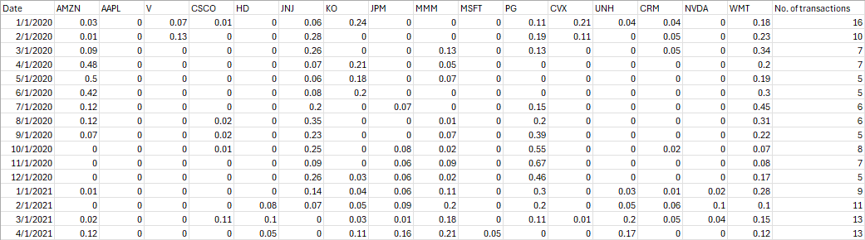
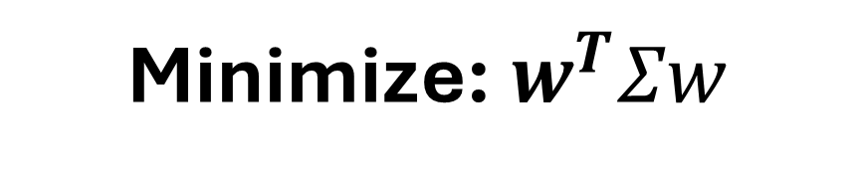
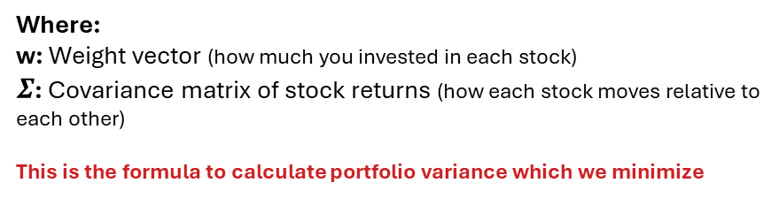
Understanding Min Variance Optimization
Objective Function
Constraints
Minimize: $w^{T}Σw$
1
NO SHORT SELLING
$$0≤w_{i}≤1$$
Where:
w: Weight vector (how much you invested in each stock)
$Σ$: Covariance matrix of stock returns (how each stock moves relative to each other)
This is the formula to calculate portfolio variance which we minimize
2
FULL INVESTMENT (NO LEVERAGE)
$$Σw_{i}=1$$
Portfolio Rebalancing
OUTPUT / RESULTS
Monthly Rebalancing
90 Days Lookback Window (Rolling Basis)

Slide 15
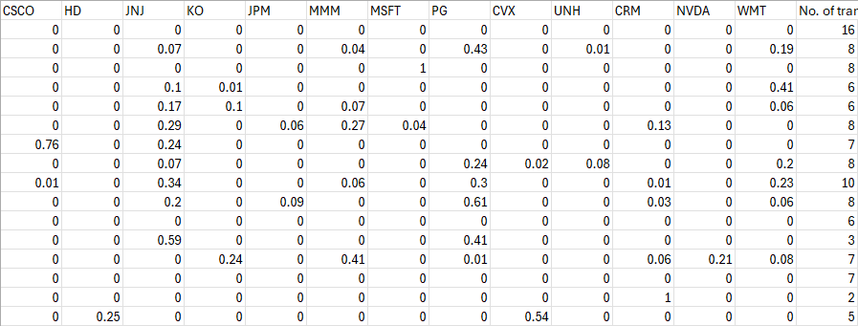
Understanding Mean Variance Optimization
Objection Function
Constraints
Minimize: $w^{T}Σw$
1
NO SHORT SELLING
$$0≤w_{i}≤1$$
Where:
w: Weight vector (how much you invested in each stock)
$Σ$: Covariance matrix of stock returns (how each stock moves relative to each other)
This is the formula to calculate portfolio variance which we minimize
2
FULL INVESTMENT (NO LEVERAGE)
$$Σw_{i}=1$$
3
EXPECTED RETURN OF AT LEAST 10%
$$μ^{T}w=0.1$$
Portfolio Rebalancing
OUTPUT / RESULTS
Monthly Rebalancing
90 Days Lookback Window (Rolling Basis)

Slide 16
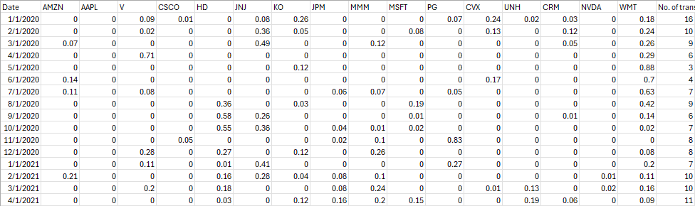
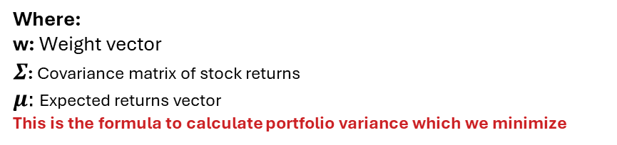
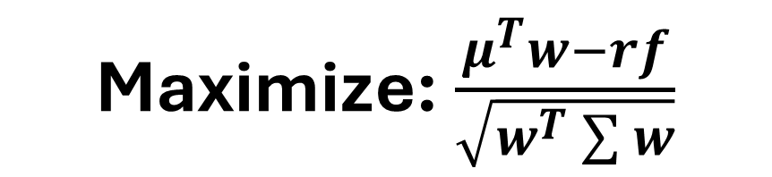
Understanding Mean Variance Optimization
Maximize Sharpe Ratio
Constraints
Maximize: $\frac{μ^{T}w−rf}{\sqrt{w^{T}\sum{w}}}$
1
NO SHORT SELLING
$$0≤w_{i}≤1$$
Where:
w: Weight vector
$Σ$: Covariance matrix of stock returns
$μ:$ Expected returns vector
This is the formula to calculate portfolio variance which we minimize
2
FULL INVESTMENT (NO LEVERAGE)
$$Σw_{i}=1$$
Portfolio Rebalancing
OUTPUT / RESULTS
Monthly Rebalancing
90 Days Lookback Window (Rolling Basis)

Slide 17
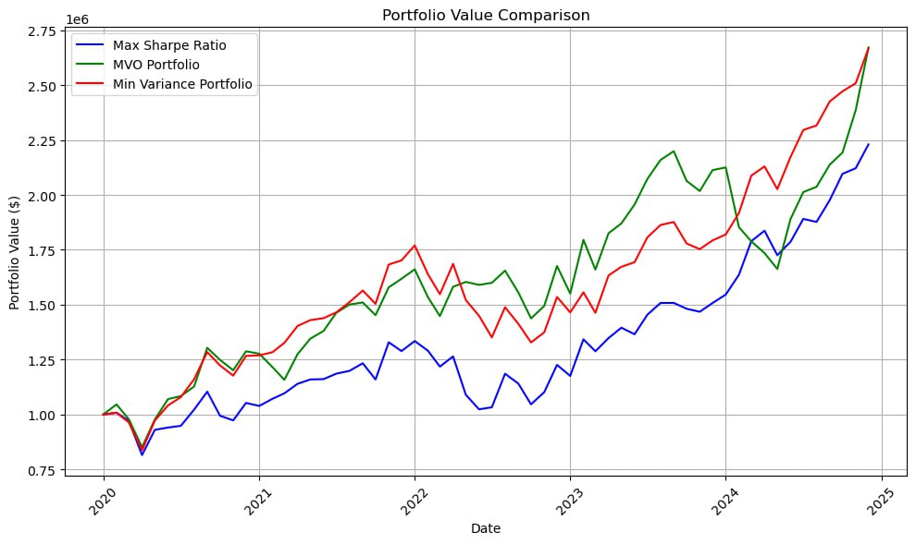
Portfolio Value Comparison
Portfolio Value Comparison (COVID-19 – UNCERTAINTY)
Expectation: MIN VAR > MVO Portfolio > Max Sharpe Ratio
Min Variance Portfolio performed better in times of uncertainty.
Max Sharpe Ratio Portfolio performed the worst in times of uncertainty
MVO Portfolio performed similar to Min Var Portfolio
COVID-19

Slide 18
Natural Language Processing

Slide 19

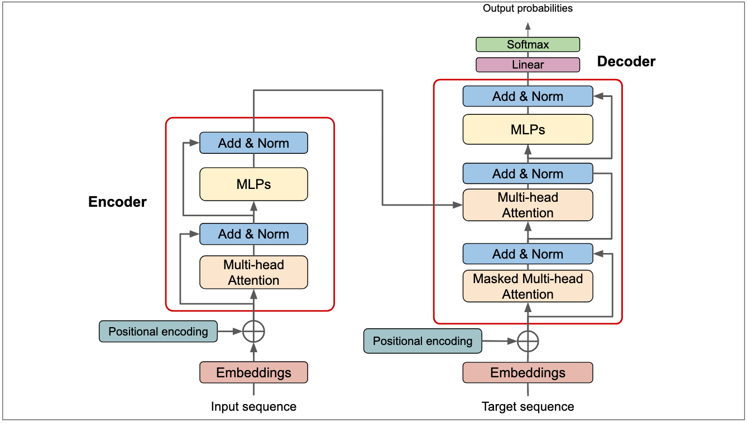
Natural Language Processing
NLP Models for Sentimental Analysis in Financial News
What is NLP
How it works
Example of an NLP Transformer Model
A field of artificial intelligence that enables computers to understand, interpret, and generate human language, allowing them to process and analyze large amounts of natural language data.
Input: Raw text (e.g., sentence, speech).
Preprocess: Clean, tokenize, normalize.
Encode: Convert words to numbers/vector representation
Model Processing: Rule-Based systems, AI (ML/DL) analyzes patterns/context.
Decoding : Used in generative tasks like translation, summarization, or chatbot responses
Task Execution: Result (translation, sentiment, etc.)
-> Output
Input → “I love this movie" → Tokenize → ["I", "loved", "this", "movie"] → Embed → [vector] → Model Predicts → Sentiment = "Positive"
Source: from (Vaswani et al. 2017).
FinBERT (Pre-trained Deep Learning Model):
A specialized NLP model built by fine-tuning BERT on a large corpus of financial texts
Designed specifically for financial sentiment classification
Effectively captures the contextual meaning of words within financial news, earnings calls, and analyst reports
Useful for identifying market-relevant sentiment signals that may not be detected by traditional models
Rationale of Using NLP In This Project
Sentiment Analysis for Forecasting:
Behavioral Signal Extraction: Captures investor psychology shifts (greed, fear, uncertainty) that precede price movements
Event-Driven Sentiment: Tracks sentiment spikes around earnings releases, Fed announcements, or geopolitical events to anticipate volatility
Sentiment Divergence: Flags when market prices diverge from sentiment trends (e.g., rising prices amid negative sentiment may signal overvaluation)
Sentiment-Based Hedging
Dynamic Hedge Ratios: Adjusts hedge size based on sentiment severity (e.g. aggressive equity shorts during extreme bearish sentiment).
How NLP Augments Portfolio Optimization
Combines quantitative metrics with qualitative sentiment signals for more informed and enhanced decision-making.
Identifies hidden risks in unstructured data (e.g. negative news flow preceding earnings shocks)
Rule-Based Model – Loughran-McDonald (LM) Dictionary (MD) :
Uses a predefined list of financial-specific words categorized by sentiment (e.g., positive, negative, uncertainty, litigious).
Counts occurrences of these words in text to determine overall sentiment.
Offers a transparent, interpretable, and consistent way to score sentiment based on word frequency.
Combining FinBERT and Rule-Based Model (Refinement Approach):
Leverages the strengths of both models.
A refinement approach that blends FinBERT’s deep contextual understanding with the consistency of rule-based keywords.
Both models complement and validate each other to improve sentiment accuracy.

Slide 20

Natural Language Processing
Methodology: Our Process and Approaches — From Data to Output
Step 1
Data Collection
Step 2
Data Preprocessing
Determine an optimal fixed number of news articles to extract over 5 years (consult with an NLP librarian expert)
Extract from Bloomberg Terminal only for consistency
Collected a total of over 2,880 financial news articles across 16 stocks
Cleaning through removing irrelevant characters, punctuation, and stopwords (e.g., "said by XX news") and changing “,” to “and” for ease of coding
Filtering through correcting noisy data (e.g., irrelevant headers, words or numbers, fix text out of context)
Step 3
NLP Coding Models
Step 4
Perform Sentiment Analysis
Utilize open-source FinBERT code from Hugging Face and open-source Loughran-McDonald (MD) dictionary lists and code
For the combined model:
Add a condition to compare if
sentiment outputs are consistent, use the
sentiment; if contradictory, treat the result as
neutral.
Pass financial headlines through NLP models to extract sentiment (positive, negative, neutral)
Compare the no. of positive vs. negative sentiments across all stocks to determine the monthly sentiment

Slide 21

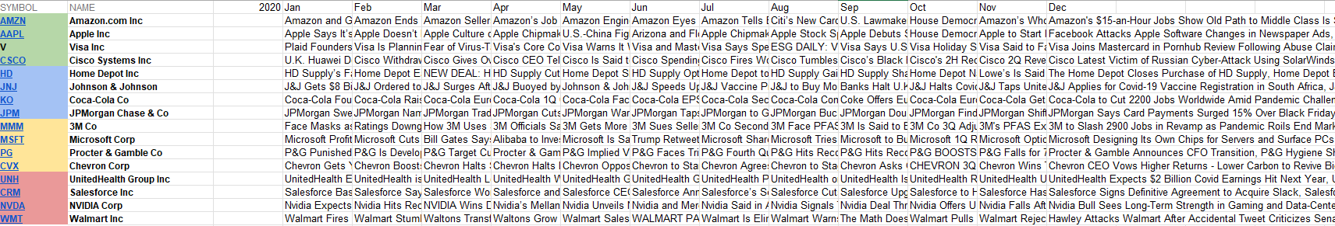
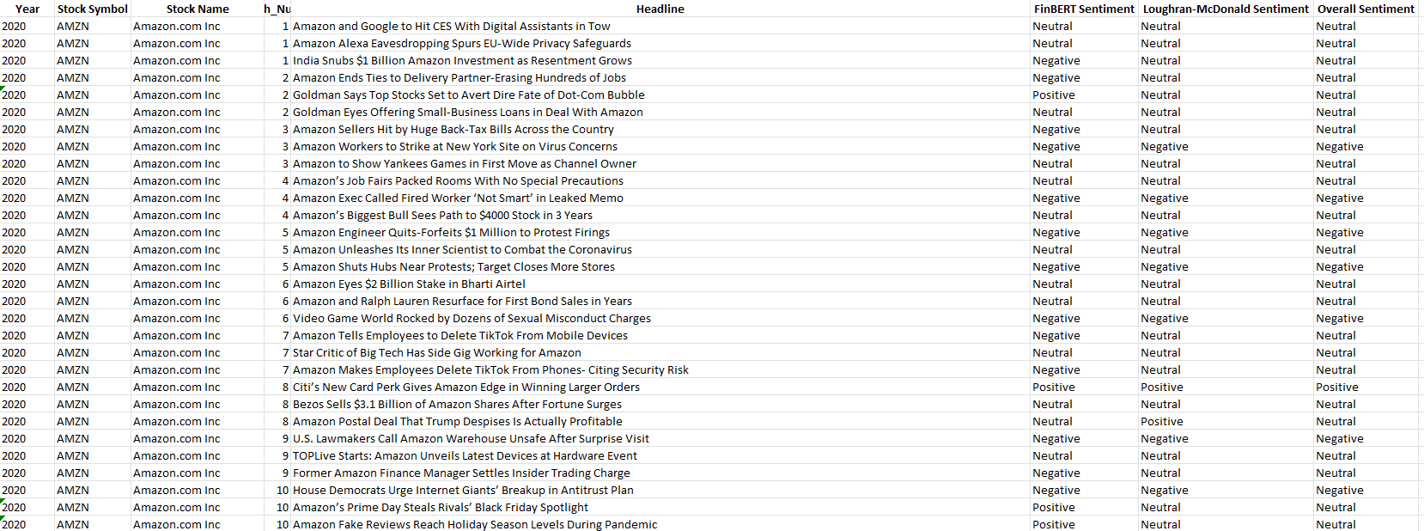
Natural Language Processing
Process of NLP Sentiment Analysis
Throughout the month
NLP Models
At the end of the month
Input Source
1
Output Source
Stocks_financial_
headlines.csv
(Respective) Sentiment_scores.xlsx
FinBERT Model
2
Rule-Based Model
3
Refined Model
4
Benchmark: ChatGPT

Slide 22
Hedging

Slide 23





Hedging
Dynamic Hedging Approach
Assumptions
Monthly Sentiment results are only available at month-end
Hedge Condition & Approach
We hedge in the following month immediately after detecting a negative sentiment score.
Since our portfolio consists of stocks from the Dow Jones Index, we only short Dow Jones Futures.
We will short at the start of the month and hold till the last day of the month.
Calculating Portfolio Beta
$$β_{i} =\frac{\operatorname{cov}\left(r_{i},r_{m}\right)}{\operatorname{Var}\left(r_{m}\right)}$$
$$Portfolio Beta, β_{ρ}=Σ(Ww_{i}×β_{i})$$
60 months Lookback Window (Rolling Basis)
Dynamic Hedge Ratios and Optimal No. of Contracts to Short
$N=h^{∗}×\frac{Q}{q}$ , where $h^{∗}$ = $β_{ρ}$
We continuously rebalance the dynamic hedge ratio, which helps to adjust the optimal number of contracts to short.

Slide 24
Back-Testing

Slide 25




Back Testing Metrics
Sharpe Ratio
$$\frac{Annualised Return −Risk Free Rate}{Annualised Volatility}$$
Terminal Return
$$\frac{Last Portfolio value −Initial Portfolio value }{Initial Portfolio value}$$
Sortino Ratio
$$\frac{Annualised Return −Risk Free Rate}{Annualised volatility of negative returns}$$
Max Drawdown (%)
$$\frac{Maximum Drawdown}{Maximum Cumulative Portfolio Value} ×100\%$$
CVaR
log_returns[log_returns <= historical_var_95].mean()

Slide 26
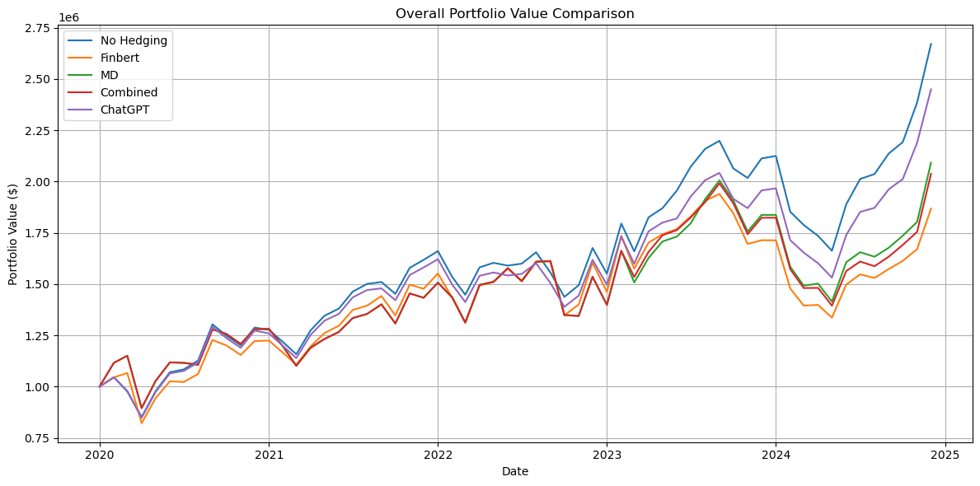
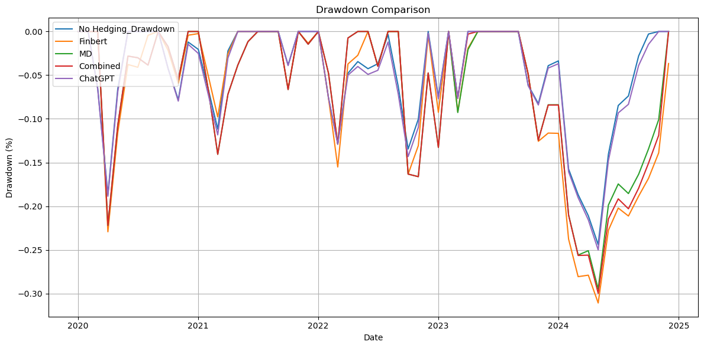
Back-Testing Results
Findings – MVO Results
Returns Metrics
 | Annualized Return (%) | Annualized Sharpe Ratio | Terminal Return (%)
No Hedging | 25.47 | 0.91 | 167.12
FinBERT | 17.82 | 0.51 | 86.84
MD | 20.86 | 0.60 | 109.22
Combined | 20.12 | 0.58 | 103.77
ChatGPT | 23.28 | 0.82 | 144.99
Risk Metrics
 | Annualized Volatility (%) | Sortino Ratio | (Monthly) CVaR (5%) | Max Drawdown
No Hedging | 23.65 | 1.99 | -11 | -24.39
FinBERT | 27.09 | 0.73 | -18 | -31.08
MD | 28.13 | 0.92 | -17 | -29.47
Combined | 27.84 | 0.88 | -17 | -29.96
ChatGPT | 23.63 | 1.80 | -11 | -25.01

Slide 27
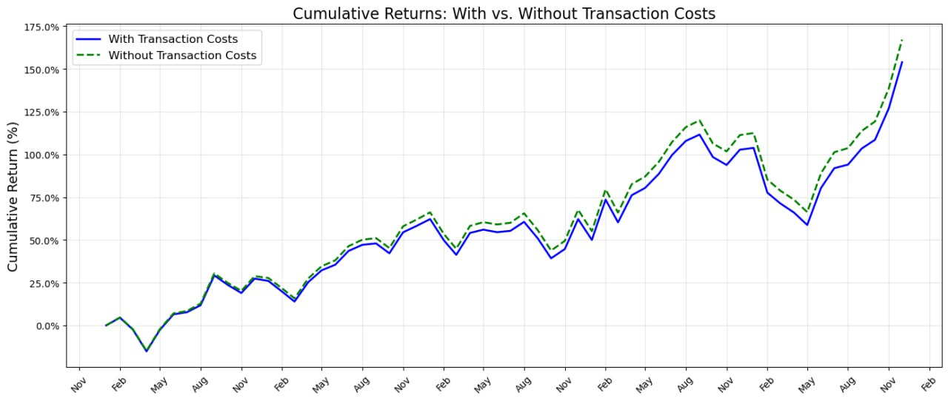
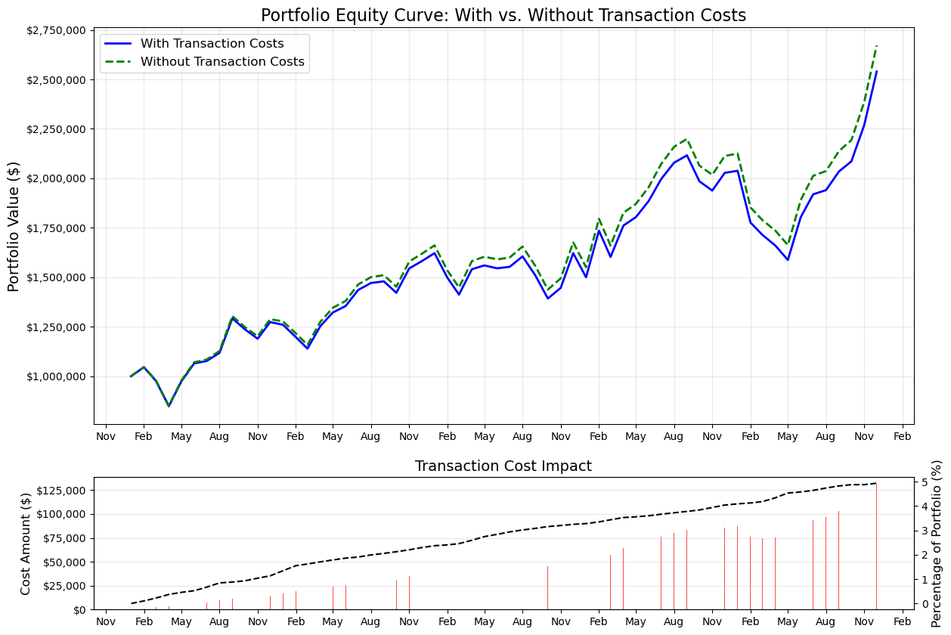
Back-Testing Results
Findings – Effectiveness of Hedging
 | Number of times Hedged (out of 60 months) | % of Positive Returns | Average % Gain/Loss Relative to Initial Portfolio Value
FinBERT | 42 | 33.33% | -0.11%
MD | 54 | 40.74% | -0.04%
Combined | 53 | 39.62% | -0.05%
ChatGPT | 2 | 0.00% | -0.03%
Back-testing alongside Transaction Cost: 1. Brokers Commission
2. Bid-Ask Spread
For both:
Weight Adjustment (per share)
Hedging Strategy (per contract)

Slide 28
Back-Testing Results
Discussion
Key Observation
Ineffectiveness of Hedging
Hedging strategies (FinBERT, MD, Combined, and ChatGPT) underperformed the "No Hedging" baseline in metrics like annualized returns, volatility, and maximum drawdown.
Implication: The cost of hedging (broker fees, bid-ask slippage) outweighed its benefits, eroding alpha.
This could also suggests the baseline portfolio’s natural diversification was enough to mitigate risk without hedging.
Volatility Paradox
No Hedging" strategy showed the lowest volatility, which goes against the traditional belief that hedging reduces risk.
Possible reasons could be due to the due to basis risk between the Dow Jones Futures and the actual assets in the portfolio.
Although the portfolio assets are part of the DJI, they may not track the index closely, causing the hedge to move in the opposite direction (e.g., portfolio declines while the DJI rises), and in turn increases return volatility.
Sentiment-Timing Failure
NLP models (FinBERT, MD, Combined, including ChatGPT) showed minimal ability in timing sentiment-driven downturns.
While ChatGPT’s strategy showed better results than other NLP models, this could be due to its under-hedging bias and does not necessarily indicate better performance, especially given its near-zero accuracy.
Rule-Based NLP Competitiveness
Simple models (e.g., MD) outperformed or matched complex NLP AI (ML/DL) models, suggest the continued relevance of simpler approaches in certain financial contexts.
This highlights the importance of model interpretability, robustness, and alignment with domain-specific dynamics over sheer complexity.

Slide 29
Benchmark

Slide 30
Introducing Benchmark Portfolios and Comparing Metrics
Benchmarks Portfolios used
Buy and Hold
Equal Weightage
Risk Parity
Tends to benefit from strong long term momentum, no transaction costs
Monthly Rebalancing, accounting for transaction costs
Rolling 12-month window to calculate individual equity vol, then balancing vol across all 16 equities
Metric Comparison
 | Buy and Hold | Equal Weightage | Risk Parity | Max Sharpe Optimization (No Hedge) | Min Variance Optimization (No Hedge) | Mean Variance Optimization (MVO) (No Hedge) | MVO + NLP Hedging (Combined Approach) | MVO + NLP Hedging (MD)
Annualised Return | 29.26% | 21.17% | 19.38% | 20.49% | 24.63% | 25.47% | 20.12% | 20.86%
Annualised Vol | 20.44% | 17.56% | 17.18% | 21.77% | 20.61% | 23.64% | 27.84% | 28.13%
Annualised Sharpe | 1.24 | 0.98 | 0.90 | 0.76 | 1.00 | 0.91 | 0.58 | 0.60
Max DD | -27.35 | -22.63% | -22.19% | -23.24% | -24.96% | -24.39% | -29.96% | -25.01%
Interestingly, Buy and Hold outperformed significantly for both returns and Sharpe. Likely due to tickers like NVDA which have sustained long runups, rewarding momentum
However, Buy and Hold’s Max DD was also greatest compared to our benchmark Portfolios
Min Var and MVO Portfolios have done well vs Equal Weightage Benchmark
Using NLP to hedge unfortunately increases vol and DD and decreases Sharpe (we observe that DJI tends to move opposite to our lagged sentiment)

Slide 31
Recommendation & Conclusion
How we might improve our project further
Quality of Data
Quantity of Data / Automating Data Collection
More optimal hedging / managing Basis Risk
Headlines selected were only from Bloomberg. Could have used the text body (but would have taken much longer to process), or other alternative data sources like X.com / Reddit / Other Financial Sites
Since data was scraped manually (as there was no Bloomberg API + to ensure that headlines were relevant to the stock), thus each ticker took 1 man hour to extract monthly news for the 5-year time period.
If data scraping can be automated
More tickers can be covered, which can reduce the variance of our portfolio
We can run simulations on more granular data and thus act faster (e.g. hedging the next day)
1. Hedging only in monthly timeframe instead of daily increases basis risk from being exposed to unintended future news events
2. Hedging entire DJI Portfolio instead of individual equities (due to optimization models tending to allocate 0 weight to most equities already). We could consider incorporating options to hedge next time, or to hedge by sector using DJI Sector ETFs.
Concluding thoughts
Our optimization models have done reasonably well (Min and Mean Variance Optimization) has outperformed an equal weightage strategy.
However, our hedging portfolios using NLP still has room for improvement, as it has only negatively impacted our metrics.
It would be best to attempt to generate returns by incorporating NLP in a way to capture news that is not published to the general public (alternative data), and act on it in a much quicker way.

